Slide 1


Team Snakebait
Tad Tatsuya Mura
Charlie Ortman
Steve Ricard
Sasha Bridges
“Taking a byte out of Medicare Costs”

Slide 2
Medicare Outcomes by County
Initial Hypothesis:
“Medicare spending will be equally and fairly
applied so patients receive consistent, high quality, health care.”
Our Process:
Areas to compare:
Data Search:
Initial csv files found – Steve
Income data found – Charlie
Data Cleanup:
Initial cleanup – Sasha and Tad
Jupyter notebook:
Initial – Sasha and Tad
Coding - All
Graphs – Sasha, Steve, Tad
Conclusion - All
Income per County:
Clay, MO
Jackson, MO
Johnson, KS
Leavenworth, KS
Sedgwick, KS
Wyandotte, KS

Slide 3
Areas of Comparison (Independent factors)
Readmission Rates:
Patients re-admitted to Hospital too soon after being discharged.
Complications & Deaths:
Patients should expect consistent, high quality care.
Medicare Spending per Patient:
Amount of Medicare dollars used to treat and care for the eligible patient.
Unexpected Hospital Visits:
Patients go to hospital (or Emergency Room) for unexpected care.

Slide 4
Data Cleaning
80% of data analysis process is data cleaning
Initially, we expected that income differences (county level) would influence health care
The information was able to be obtained from cms.gov, medicare.gov and the census bureau.
API’s were available but the sites presented data filtering tools –
allowing smaller more manageable csv formatted files.
Many of the columns were Object-type
We saw “Score” columns frequently but they had different meanings for each file
We tried casting them to floats, but ran into issues with NaN columns and null values
Trying to replace the NaN columns led us to realize that Data Series values are ambiguous, and you can’t directly compare them to a value
Experimented with VBA scripting but there was too much data and it didn’t work

Slide 5
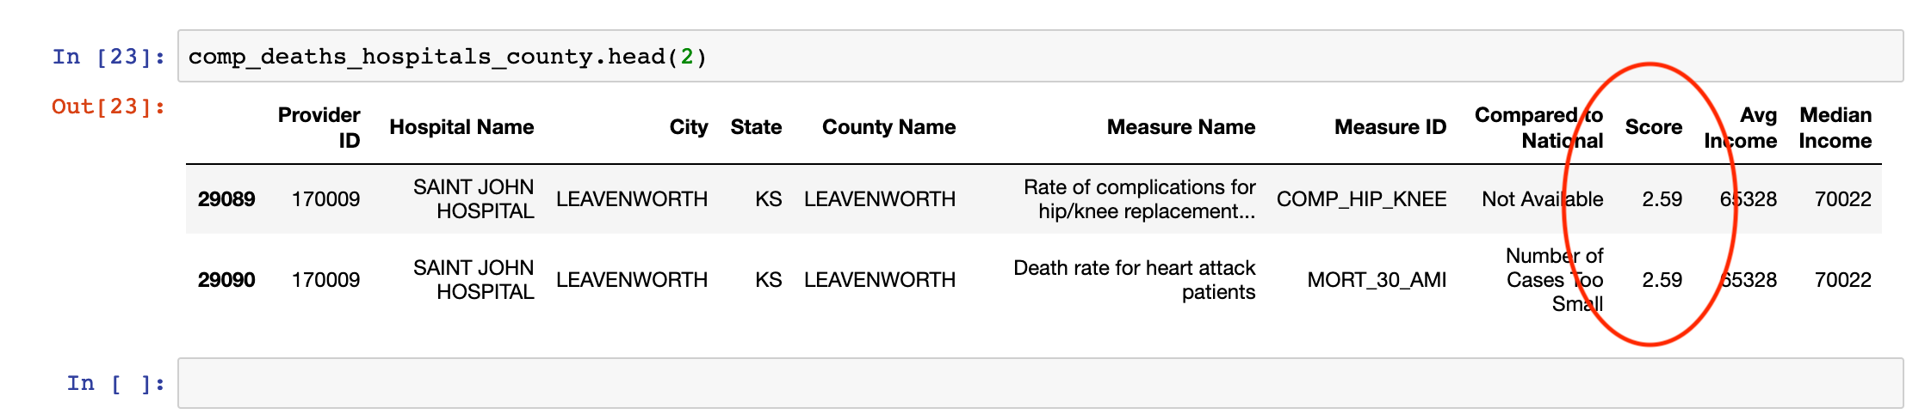
Data Cleaning (continue)
Ignoring missing values vs filling reasonable numbers:
DataFrame.dropna = lose accuracy
Create your own function
Lambda function
I. e. df[‘Score’].apply(lambda x: x.fillna(x.mean()),axis=1)
Normalizing data (rescaling or standardizing)
dfA score range: 0 to 200
dfB score range: -30 to 50

Slide 6
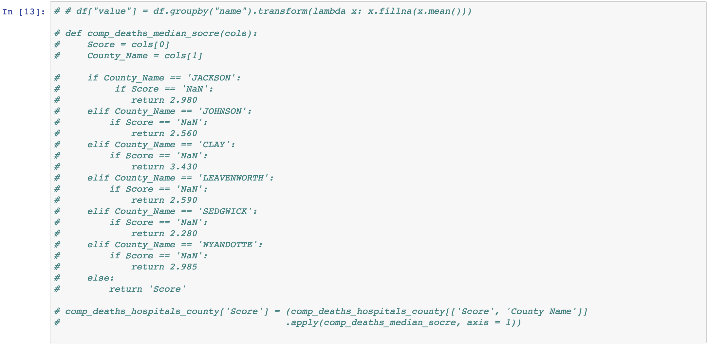

Slide 7
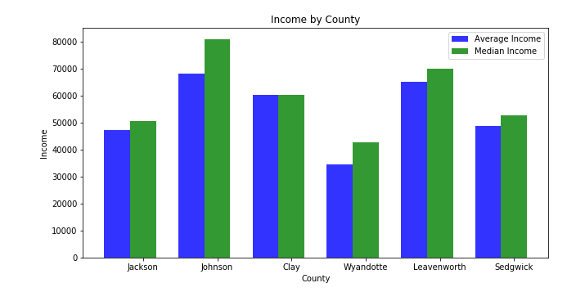
Income by County
What is the income per county in Kansas and Missouri?
Higher Income ~ Better Care
If a county has lower Medicare spending
then there are more unexpected hospital visits.

Slide 8
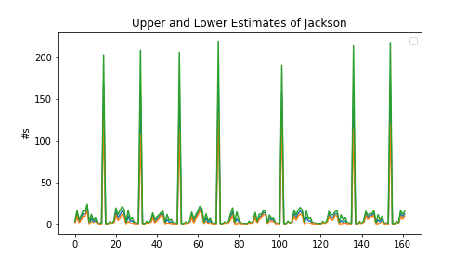
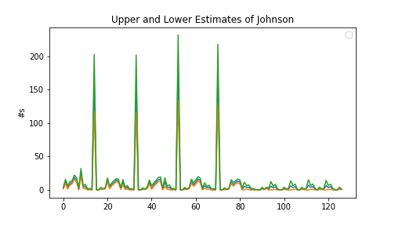
Estimate per score of Complications and Deaths
Are the hospitals within range of their estimates?
The 6 counties where above the estimate

Slide 9
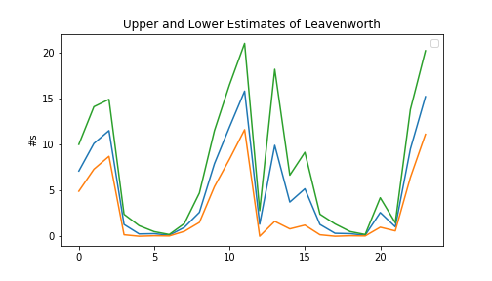
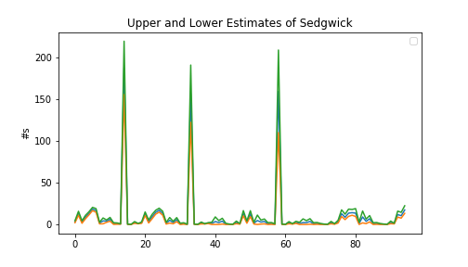
Estimate per score of Complications and Deaths
Are the hospitals within range of their estimates?
The 6 counties where above the estimate

Slide 10
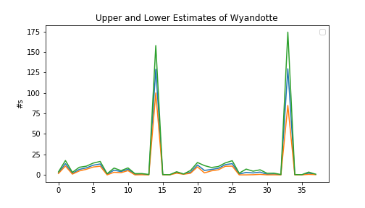
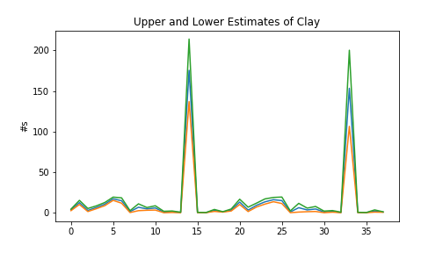
Estimate per score of Complications and Deaths
Are the hospitals within range of their estimates?
The 6 counties where above the estimate

Slide 11
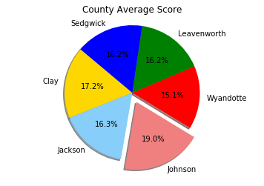
The Medicare Spending Per Patient
Does Medicare spends more, less, or about the same for an episode of care?
This measure takes into account important factors like patient age and health status
Based on the average score per county:
Johnson County spends more

Slide 12
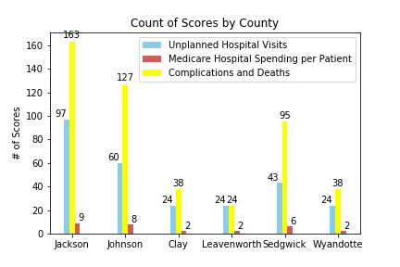
Is there a relationship between higher Medicare spending and how much data is recorded?

Slide 13
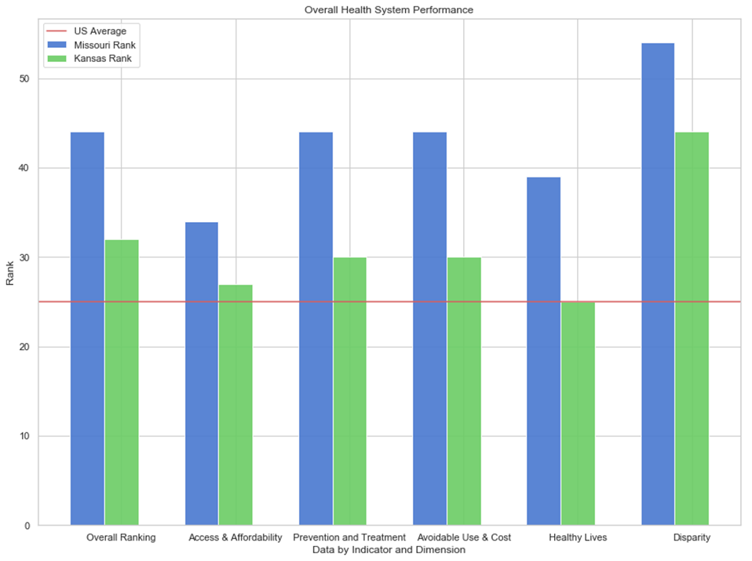
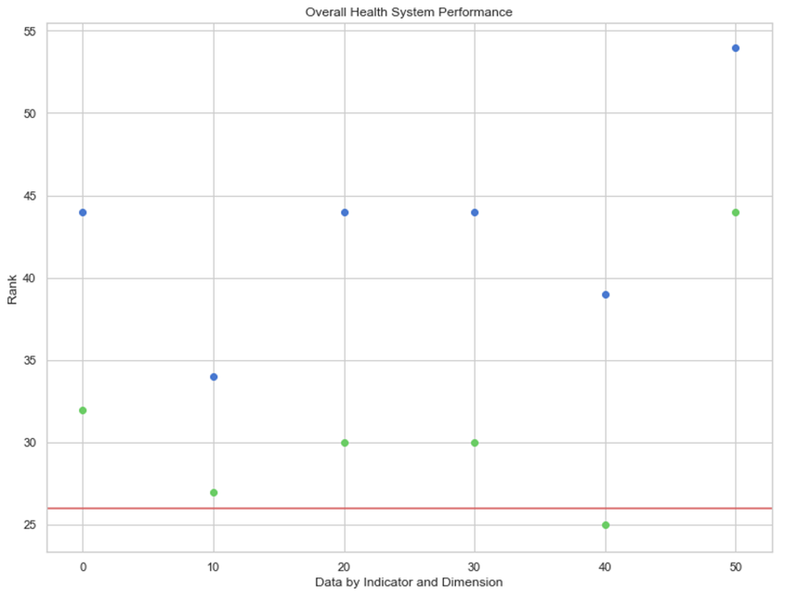
Health System Performance
How Does Medicare in Kansas and Missouri Compare to the National Rank?

Slide 14
Health System Performance
How Does Medicare in Kansas and Missouri Compare to the National Rank?
Overall Rank
50 States and the District of Columbia
Access and Affordability
Adults ages 19-64 uninsured
Adults without a unusual source of care
Adults who went without care because of cost
Prevention and Treatment
Adults without all age and gender
appropriate cancer screenings
Adults without all age-appropriate
Hospital 30-day mortality
Healthy Lives
Colorectal cancer deaths
Deaths from suicide, alcohol, and drug use
Adults who report fair/poor health
Adults who smoke
Disparity
Adults ages 19–64 uninsured
Adults without a usual source of care
Adults who went without care because of cost
Avoidable Hospital Use and Cost
Admissions for ambulatory care–sensitive conditions
30-day hospital readmissions
Home health patients with a hospital admission

Slide 15
Conclusion
Based on the data, Medicare is directly related to the income.
CMS.gov files are difficult to work with
There is a correlation between data recorded and Medicare money spent
Medicare outcomes differ by county
Readmission rate different among 6 counties
Complications and Deaths were differ among 6 counties
Unexpected hospitable visit also differ among the 6 counties
Medicare spending per patient per patient

